Slide 1
Resilience and percolation
The structure and dynamics of multilayer networks
Chapter 4
多层网络的韧性与渗流

Slide 2
Chapter 4 Outline
4.1. The fragility of multilayer interdependent networks
4.2. Percolation in interdependent networks
4.3. Interdependent multiplex networks
4.4. Interdependent networks of networks
4.5. Effects of correlations and embedding space on percolation properties of multilayer networks
4.6. Other percolation problems
4.7. Cascades on multilayer networks

Slide 3
4.5 Effects of correlations and embedding space on percolation properties of multilayer networks
4.5.1 Percolation in networks with overlap of the links
4.5.2 Percolation in networks with degree correlations
4.5.3 Percolation in spatial multiplex networks
这一节的核心意思是：多层网络的渗流行为不只看层数和度分布，还强烈依赖层间连边重叠、节点度在层间的相关性，以及网络是否嵌入真实空间。

Slide 4
4.5.1 Overlap of Links
“The overlap of the links can change significantly the properties of the percolation transition.”
链接重叠会显著改变渗流相变的性质。
“In the limit in which we have a multiplex of M totally overlapping layers, the mutually connected giant component of the multiplex is identical to the giant component of a single layer, and the percolation transition is of the second order.”
如果 M 层完全重叠，MCGC 等价于单层巨分量，渗流是连续二阶相变。

Slide 5
Overlap: Expectation and Debate
“It would be natural to expect that, when the overlap between the layers is over a threshold value, the emergence of the mutually connected component is continuous, while when the overlap is below such a critical value, the emergence of the mutually connected component is described by a hybrid transition.”
一个自然预期是：重叠超过阈值时，MCGC 连续出现；低于阈值时，表现为混合相变。
“This problem was tackled by several groups ...”
介绍了一些相关工作。提出了争议：有的研究找到三临界点，认为重叠达到一定值后转变会从discontinuous变成continuous；另一些研究则认为：只要还存在非重叠链接，转变仍然可能是不连续的。

Slide 6
4.5.2 Degree Correlations
“The presence of degree correlations in multiplex networks can modify drastically the percolation threshold ...”
多层网络中，同一个节点在不同层里的度可能相关。多层网络中的度相关会剧烈改变渗流阈值。
三种类型：
MP：maximally-positive correlated，最大正相关，同一节点在各层都是高度节点；
MN：maximally-negative correlated，最大负相关，高度节点在另一层对应低度节点；
UC：uncorrelated，不相关。

Slide 7
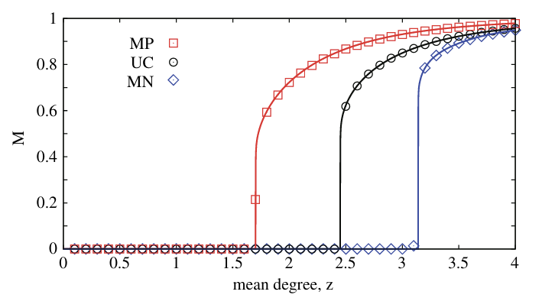
MP vs MN vs UC
“For maximally-positive correlated multiplex networks, the percolation threshold p_c is smaller than that for the maximally-negative correlated case. The networks with uncorrelated degrees in the different layers have a percolation threshold p_c that is in between the previous two.”
MP 情况下，相互连接巨分量更早出现；
MN 情况下，需要更高的平均度才出现。

Slide 8
4.5.3 Spatial Multiplex Networks
“Many networks are not only interdependent, but also embedded in a physical space. For instance, infrastructures are mostly spatial and therefore it is essential to investigate the role of space in determining their robustness.”
很多网络不仅相互依赖，还嵌入物理空间。基础设施尤其如此，因此必须研究空间对鲁棒性的影响。
“When the multiplex networks are embedded in real space, the interdependencies do not always sharpen the percolation transition.”
当多层网络嵌入真实空间时，相互依赖并不总是让渗流转变更尖锐。

Slide 9
Spatial Distance and Transition Type
The nature of the percolation transition can depend on the typical distance in space of the interdependent nodes ... “By modulating the typical ...
相互依赖节点之间的典型空间距离很关键：
  距离大 → 一个地方故障可能远程触发另一层故障，转变可能不连续；
  距离小 → 故障更局部化，系统行为可能更平滑，转变可能连续。

Slide 10
4.6 Other percolation problems
4.6.1 Classical percolation
4.6.2 Percolation of antagonistic networks
4.6.3 K-core percolation
4.6.4 Viability in multiplex networks and weak percolation
这一节讲的是：不是所有多层网络渗流都等同于“相互依赖 MCGC 渗流”。有几类重要变体。

Slide 11
4.6.1 Classical Percolation
“The percolation of multilayer networks can also be studied in the absence of interdependencies. This is the case in which all the connections, either those between nodes in the same layer and those between nodes in different layers, have the same role and all the links are ‘dependency links’.”
没有相互依赖，层内和层间链接同等看待，所有链接都像“依赖链接”。
“A node of the structure belongs to the giant component of the multiplex if at least one of its links connects the node to the giant component.”
一个节点只要通过任意一条链接连到巨分量，就属于巨分量。

Slide 12
4.6.2 Percolation of Antagonistic Networks
核心设定：
  "The function or activity of a node is incompatible with the function or activity of the replica node in the other layer."
  一个节点在某一层的功能或活跃状态，与它在另一层的副本节点不相容。
判断规则：
  本层有活跃邻居；另一层副本的邻居都不活跃。
与 MCGC 对比：
 | MCGC | 对抗渗流
层间关系 | 合作 | 排斥
节点存活条件 | 所有层副本都活 | 本层活 + 另一层不活

Slide 13
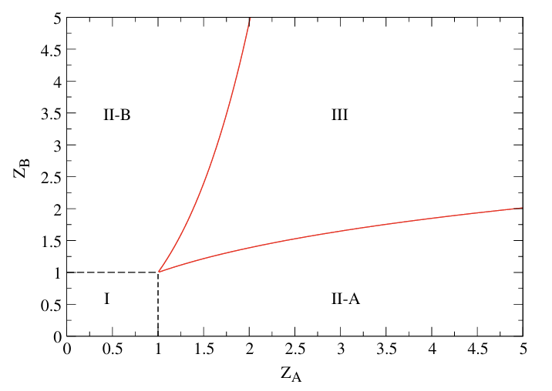
4.6.2 Percolation of Antagonistic Networks
Bistability and Hysteresis：
  Region I：Z_A<1,Z_B<1；两层都不渗流。
  Region II-A：Z_A足够大,Z_B小；只有 A 层渗流，B 层不渗流。
  Region II-B：Z_B足够大,Z_A小；只有 B 层渗流，A 层不渗流。
  Region III：两层都足够大，双稳：要么 A 渗流 B 不渗流，要么反过来，取决于初始条件。
关键结论：
  层间排斥 → 双稳 + 迟滞；
  同一时刻只有一层能渗流（在竞争区域）；
  系统状态依赖历史路径。
对抗渗流 = 层间互斥的多层渗流。节点在 A 层活跃就要求 B 层不活跃。结果是双稳和迟滞：系统要么 A 渗流，要么 B 渗流，取决于初始条件和历史路径。

Slide 14
4.6.3 K-core Percolation
“The k-core of multiplex networks was defined as the set of nodes between which there are ...”
普通渗流看巨分量；k-core 渗流看每层至少有 k 条路径连接的节点集合。在多层网络中，k-core 的定义是：节点之间在每一层至少有 k<=2 条路径连接。
在 duplex 中，k-core 总是以不连续方式出现，不管度分布如何。这意味着多层网络的 k-core 比单层网络更脆弱：随机移除节点时，k-core 可能突然崩溃，而不是逐渐消失。
多层 k-core 问题比单层更丰富，也更不鲁棒。

Slide 15
4.6.4. Viability in multiplex networks and weak percolation
“Each layer has a certain number of resource nodes. Each node of the multiplex will then belong to the viable cluster of the resource network, if it is connected by at least one path to a resource node in each layer ...”
每层有若干"资源节点"。一个多层节点要"可行"，必须满足：在每一层中，都能通过至少一条路径到达该层的资源节点。
可行节点比例随网络密度和资源节点比例变化时，会出现：
  discontinuity，不连续：可行簇突然出现或消失；
  bistability，双稳：系统可能停在两个稳定状态之一；
  hysteresis，迟滞：状态依赖历史路径，恢复和损坏走的是不同的曲线。
可用于基础设施。由于迟滞效应，从损坏中恢复可能极其缓慢且困难——同样的资源节点比例，损坏前系统能正常运行，损坏后却回不到原来的状态。

Slide 16
4.6.4. Viability in multiplex networks and weak percolation
 | MCGC | Viability
存活条件 | 每层中属于巨分量 | 每层中能连到资源节点
是否需要巨分量 | 需要 | 不需要，只要能连到资源即可
资源节点角色 | 无 | 核心，是"活着的源头"

Slide 17
Weak Percolation
1. 弱自举渗流 Weak Bootstrap Percolation
  “The weak bootstrap percolation describes the recovery of multiplex networks.”
  描述多层网络的恢复过程。
  自举渗流（bootstrap percolation） 的经典含义是：一个节点如果有足够多的活跃邻居，它就被"拉活"。弱自举渗流是多层版本。
2. 弱修剪渗流 Weak Pruning Percolation
  “The weak pruning percolation describes the deactivation/damage propagating processes in a multiplex structure.”
  描述多层结构中的去激活/损坏传播过程。
  修剪渗流（pruning percolation） 的经典含义是：一个节点如果活跃邻居太少，它就被"拉死"。弱修剪渗流是多层版本。

Slide 18
Weak Percolation
关键结论
  “While bootstrap percolation and pruning percolation on single-layers are equivalent, Ref. [197] shows that they do differ in the multiplex case.”
  在单层网络中，自举渗流和修剪渗流是等价的（同一过程的正反两面）；但在多层网络中，它们不同。
  这是一个重要的发现：单层中对称的两个过程，在多层的层间耦合下失去了对称性。
相变类型对比：
过程 | duplex（2 层） | multiplex（≥3 层）
弱自举渗流（恢复） | 连续 + 不连续转变 | 连续 + 不连续转变
弱修剪渗流（损坏） | 只有连续转变 | 混合不连续转变
核心结论：层数增加时，弱修剪渗流的转变反而从连续变成不连续。

Slide 19
4.7. Cascades on multilayer networks
“In multilayer networks, cascades can be caused not only by interdependent percolation but also by other processes including cascades of loads ..., the Bak-Tang-Wiesenfeld sandpile model ..., the threshold cascade model ... or by novel cascade processes.”
多层网络中的级联不仅来自相互依赖渗流，还来自：
  cascades of loads，负载级联——如电力网中的负载重分配；
  Bak-Tang-Wiesenfeld sandpile model，沙堆模型——描述雪崩；
  Watts threshold model，Watts 阈值模型——描述行为采纳；
  novel cascade processes，新级联模型——Ref. [201] 提出。

Slide 20
负载级联 Cascades of Loads
"In Ref. [81] cascades of loads have been proposed to study the robustness of multilayer infrastructures and power-grids. In that work, it has been ..."
Ref. [81] 用负载级联研究多层基础设施和电力网的鲁棒性。适度增加层间连接可以减少每层最大级联的规模，因此是有利的。
"Nevertheless, it has been shown that too much interconnections can ..."
但层间连接过多反而有害，原因有二：
  一层可以把大级联传给相邻层；
  新连接增加了容量和总负载，最终产生更大级联。
核心结论：层间连接不是越多越好，存在一个最优水平。太少 → 缺少备份路径；太多 → 级联跨层传播。

Slide 21
沙堆模型 Sandpile Model
"In Ref. [198] the role of multiplexity in the sandpile dynamics was further explored, showing that the ..."
Ref. [198] 研究 multiplexity 对沙堆动力学的影响，发现雪崩规模分布不受 multiplexity 影响。但详细动力学受影响。例如，多层网络中的高度节点比单层网络中更常失效。
核心结论：
层面 | 是否受 multiplexity 影响
雪崩规模分布（宏观） | 不受影响
详细动力学（微观） | 受影响，高度节点更常失效
关键对比：单层网络中高度节点是"鲁棒"的（因为度大，不易孤立）；但多层网络中高度节点反而更容易失效——这又是一个反直觉结论。

Slide 22
Watts 阈值模型
"In Ref. [50] cascades of adoption of a behavior, such as ideas or financial strategies, or movement to join, are studied with the Watts model [200]. It is shown that multiplexity can actually increase the network vulnerability to global cascades."
Ref. [50] 用 Watts 模型研究行为采纳级联——如观点、金融策略、加入运动等。发现 multiplexity 反而增加网络对全局级联的脆弱性。
"This has relevance for advertising strategies that can become more effective with an increasing multiplexity, or for banks that might become more vulnerable with every new layer in the multiplex."
对广告策略：multiplexity 越高，广告越有效（因为行为传播更快）；
对银行系统：每增加一层，银行系统可能更脆弱（因为级联更容易扩散）。

Slide 23
新级联模型
"In Ref. [201] a novel cascade model, inspired by the Watts threshold model, has been considered in which some nodes adopt a behavior ..."
Ref. [201] 提出新级联模型，基于 Watts 阈值模型：
  部分节点：需要所有层中足够多邻居都采纳，才采纳行为；
  另一些节点：只要某些层中足够多邻居采纳，就采纳行为。
"This model can either inhibit or facilitate the cascade of events. Moreover, the model in some region of the phase space, allows for abrupt ..."
该模型可以抑制或促进级联；
在某些相空间区域，级联会突然出现——揭示新的雪崩触发机制；
可用于理解 civil movements（社会运动）、product adoption（产品采纳）。

Slide 24
Chapter 4 Summary
相互依赖会让网络从“鲁棒”变“脆弱”。
MCGC 是判断多层网络是否还活着的核心量。
完全依赖常导致突然崩溃；部分依赖、重叠、正相关、空间短依赖可能让崩溃变平滑或更鲁棒。
重叠、度相关、空间距离都会改变多层网络渗流的阈值和相变类型。
经典渗流、对抗性网络、k-核、可行性、弱渗流各有不同相变行为。
级联不止来自相互依赖渗流；负载级联、沙堆模型、阈值模型各有不同机制。共同点是：层间连接存在最优水平，multiplexity 既可能促进也可能抑制级联，取决于具体过程。

